Slide 1
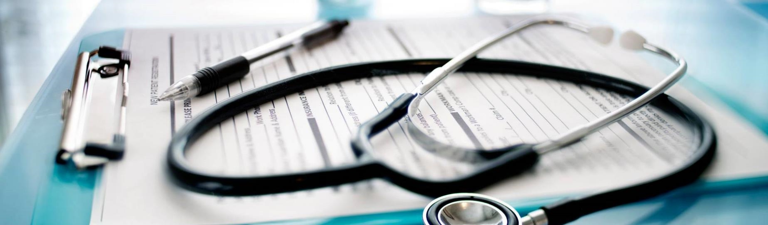
Predicting likelihood of Cardiovascular disease
Richard Thomas, Charlie Smoot, Nick Brannum, Jesse Eng

Slide 2



Introduction
For our final project we chose to build a machine learning model that can predict whether someone is high risk for cardiovascular disease or not. To build this model we utilized data that was collected on over 200,000 individuals from a list of health-related survey questions. Finally, we deployed our machine learning model to a website so that anyone can fill out the survey questions for themselves and get their prediction.

Slide 3
Explanation of data used
Features | Target
Exercise (Boolean) | Heart Disease (Boolean)
Skin Cancer (Boolean)
Other Cancer (Boolean)
Depression (Boolean)
Diabetes (Boolean)
Arthritis (Boolean)
Sex (Categorical)
Age (Categorical)
Height (integer)
Weight (float)
BMI (float)
Smoking History (Boolean)
Alcohol Consumption Monthly (integer)
Fruit Consumption Monthly (integer)
Fruit Consumption Monthly (integer)
Green Vegetable Consumption Monthly (integer)
Fried Potato Consumption Monthly (integer)
BRFSS Dataset
The Behavioral Risk Factor Surveillance System (BRFSS) is the nation’s premier system of health-related telephone surveys that collect state data about U.S. residents regarding their health-related risk behaviors, chronic health conditions, and use of preventive services.
Pros of this dataset
Lots of features (17)
Lots of rows (224,484)
Overall, the data was very clean and easy to work with
Cons of this dataset
Large data imbalance with the target column (206,371 rows with no heart disease and 18,113 rows with heart disease)
Link to dataset: https://www.kaggle.com/datasets/alphiree/cardiovascular-diseases-risk-prediction-dataset

Slide 4
Preprocessing data
One hot encoding
Turn “yes” entries into a “1” and “no” entries into a “0”
Convert sex column into 2 separate Male and Female columns
Convert age column into 13 separate columns (One for each age bracket)
Split into train and test
Utilized SciKitLearn train_test_split to properly divide the data into a training set and test set. (Used default setting of 75% train data and 25% test)
Scaling the data
Utilized SciKitLearn StandardScaler to properly scale each column due to having numeric columns alongside one hot encoded columns
Oversampling
First, we tried using the Random Oversampler from imblearn to oversample the “1”s in the target column
Next, we also utilized SMOTE from imblearn because the random oversampler was not producing the results we liked so we used SMOTE to try and increase precision of the model.

Slide 5

Iterating on machine learning models

Slide 6
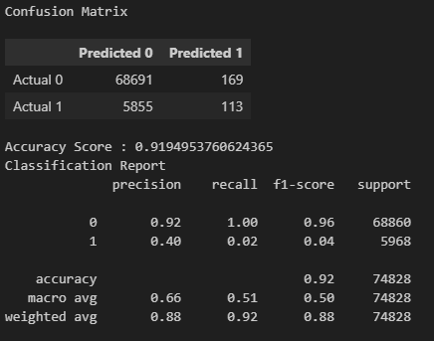
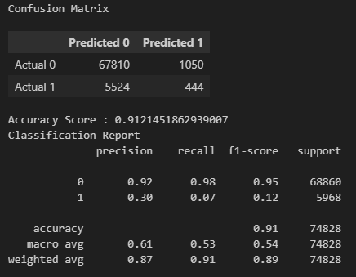
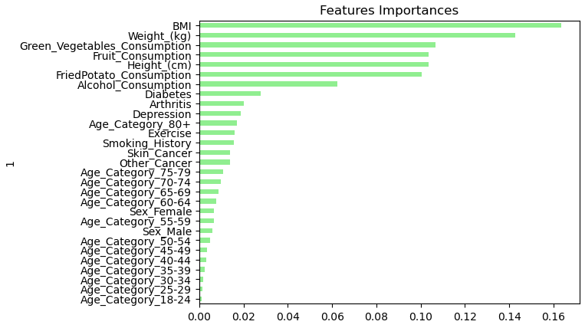
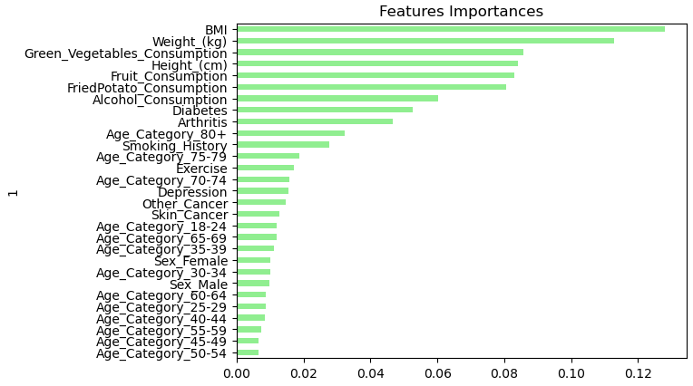
Random Forest
The first model we attempted was the random forest model because we were interested in being able to see the ranking of feature importance's that this model can produce.
Without random oversample
With random oversample
The first pass on the random forest model gave a high accuracy of 92%; however, the recall on “1”s in the test dataset was low at .02
Utilizing the random oversample to reconcile the low recall on “1”s only improved it by .05 while decreasing overall accuracy by 1%
The interesting learning from this model was that it was able to show which features were most important for predicting cardiovascular disease
BMI is the highest
Age importance increases by age group

Slide 7
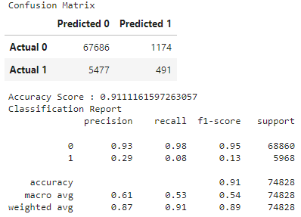
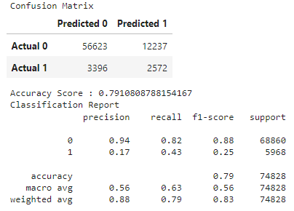
K nearest neighbor
The second model we attempted was the K-nearest neighbor model
The first pass on this model without oversampling yielded a similar performing model to the random forest with an overall accuracy of 91% and recall on “1”s of .08
When we introduced oversampling the model accuracy dropped to 79% but the recall on “1”s increased from .08 to .43
Without random oversample
With random oversample

Slide 8
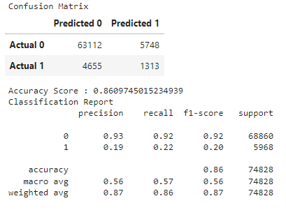
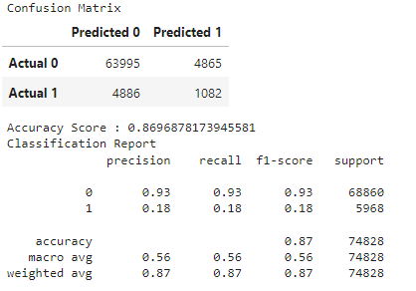
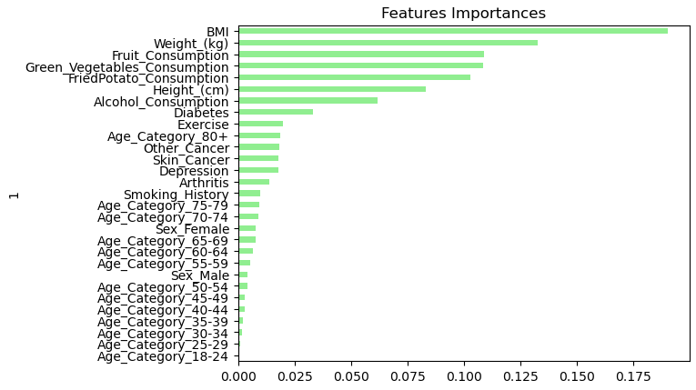
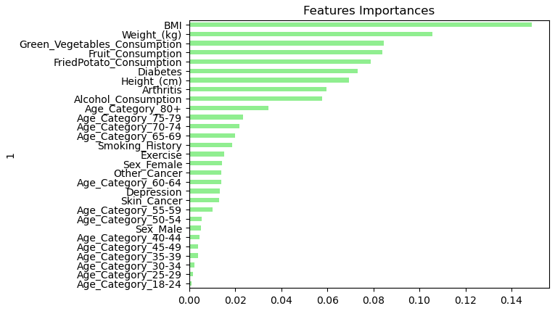
Decision tree
The first pass on this model without oversampling yielded an accuracy of 86% and recall of 0.22 for “1”s
When we introduced oversampling the model accuracy increased to 87% but the recall got worse (from 0.22 to 0.18)
This model also was able to output the feature importance's which aligned well to the random forest model.
With random oversample
Without random oversample

Slide 9
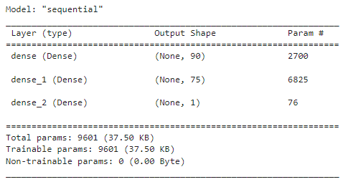
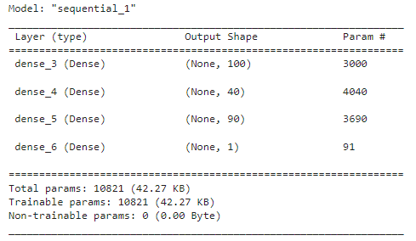
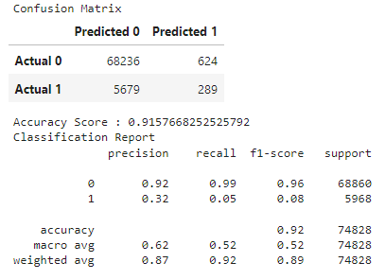
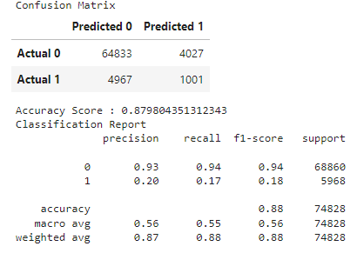
Neural network
Lastly, we decided to create a neural network since the traditional machine learning models were not giving us satisfactory results.
Without random oversample
With SMOTE
The first pass on the neural network without SMOTE gave an overall accuracy of 92% and a recall for “1”s of .05
This model utilized 2 hidden layers with 90 and 75 neurons respectively
The second pass on the neural network utilized SMOTE which lowered the overall accuracy to 88% but increased our recall from .05 to .17.
This model utilized 3 hidden layers with 100,40, and 90 neurons respectively

Slide 10
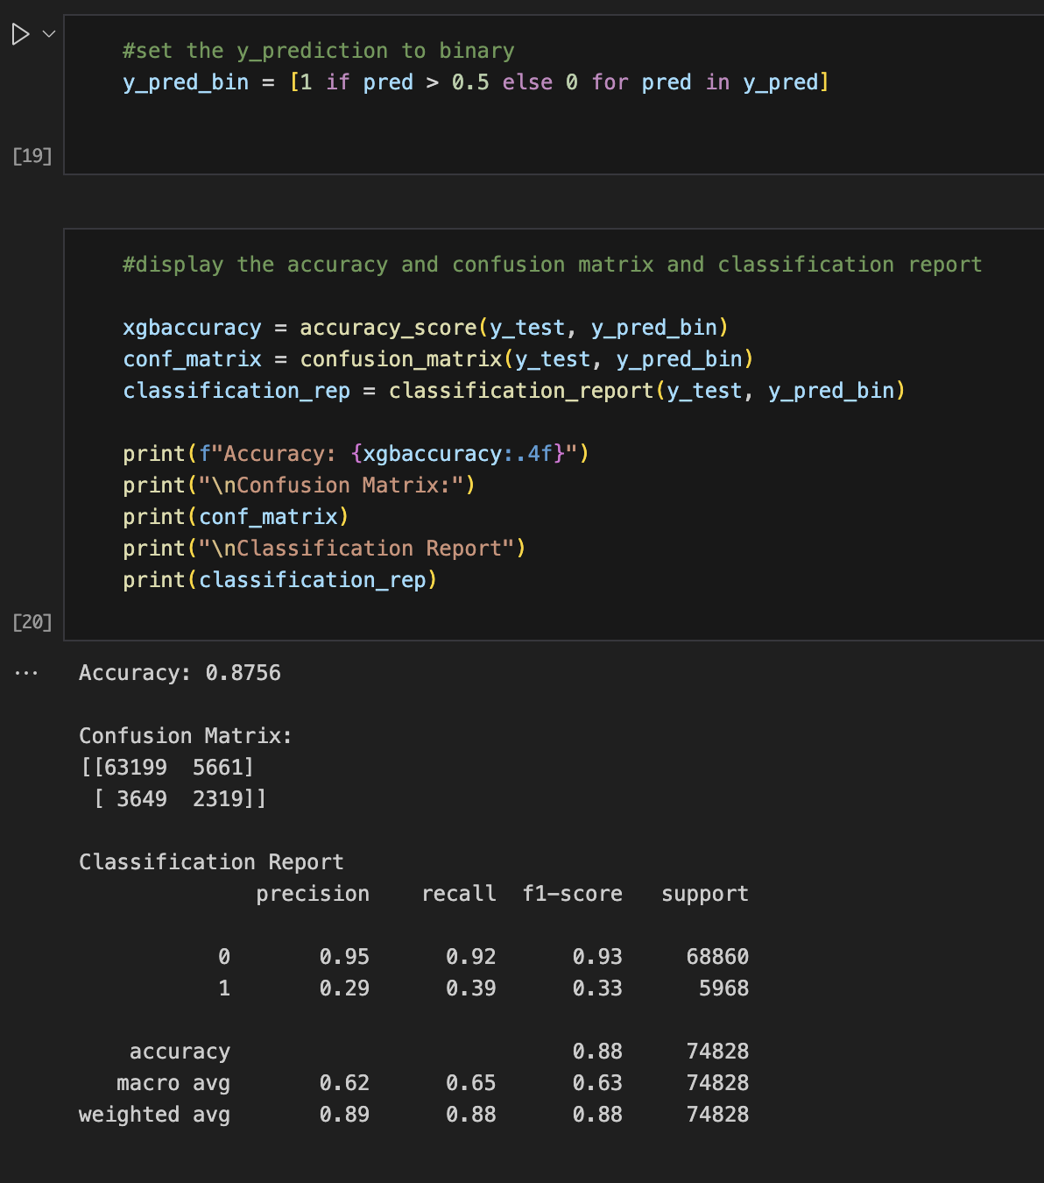
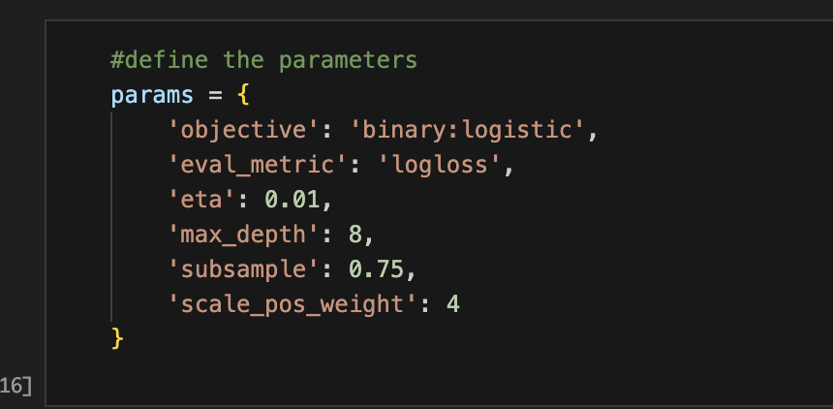
XGBoost
Our data had significant more samples for no heart disease, so we tested using this model to accommodate. This model allows us to set parameters including sample percentage, max tree depth, and scale weight. The scale weight of 4 is to accommodate the imbalance of positive and negative heart disease samples, or 0 and 1 for the binary classification. The following parameters gave the highest f1-score output.

Slide 11
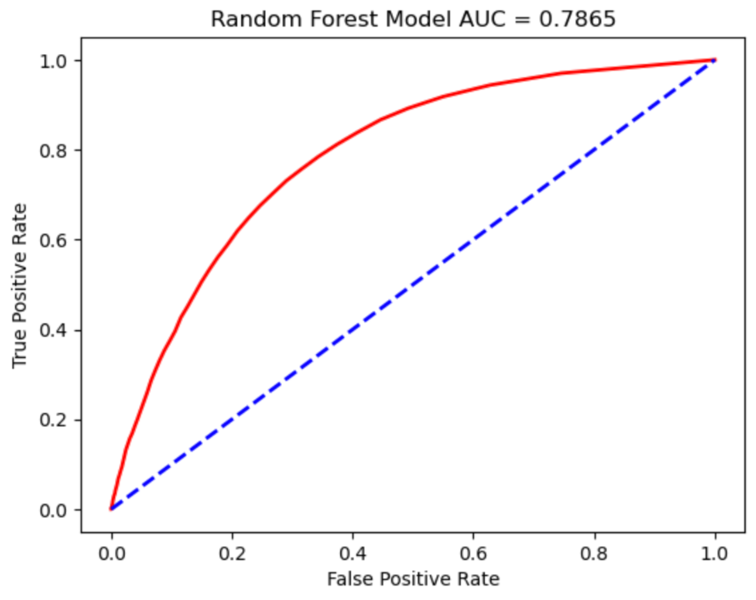
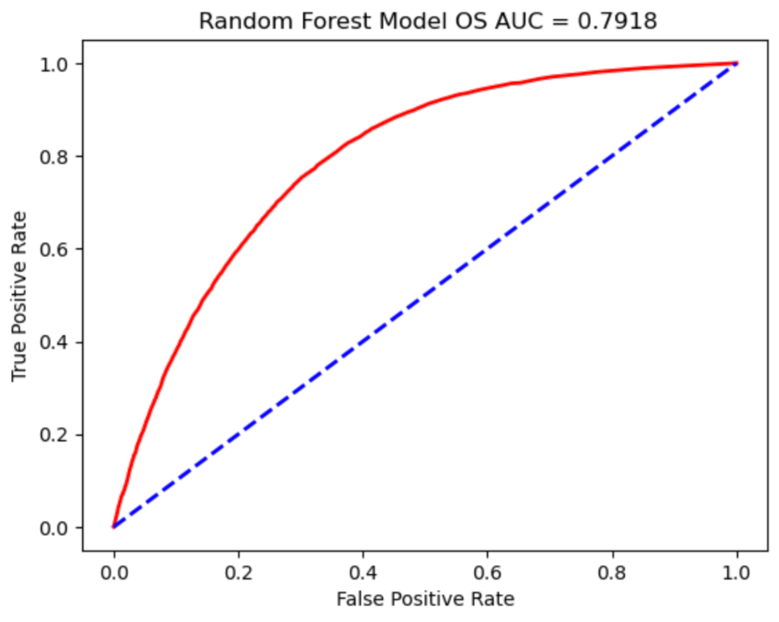
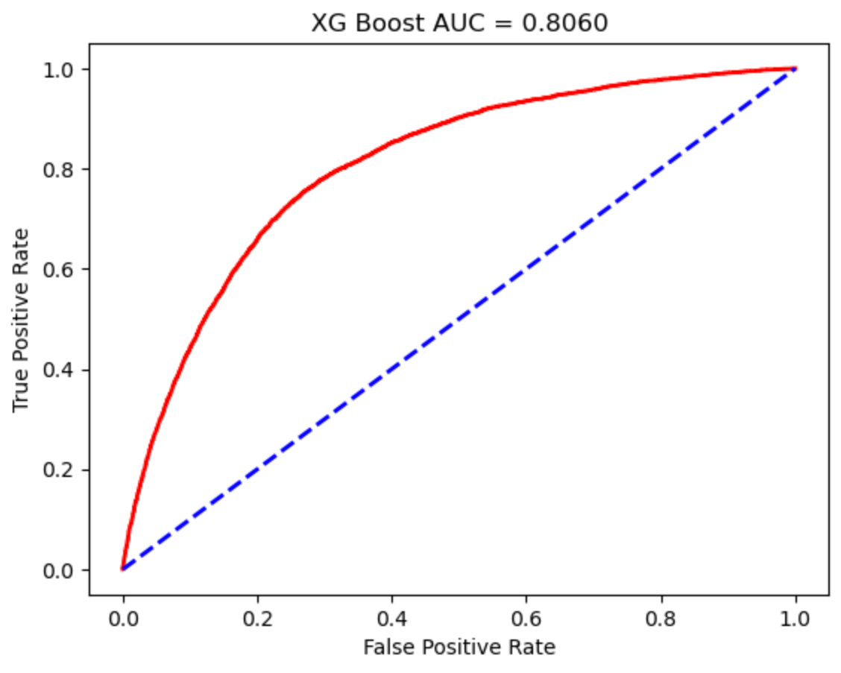
ROC Graphs
ROC graphs helped us to evaluate the effectiveness of binary classifier models
The goal of each machine learning model is to have as high of a true positive rate as possible
Xgboost proved to be our best model

Slide 12


Deploying the machine learning model

Slide 13
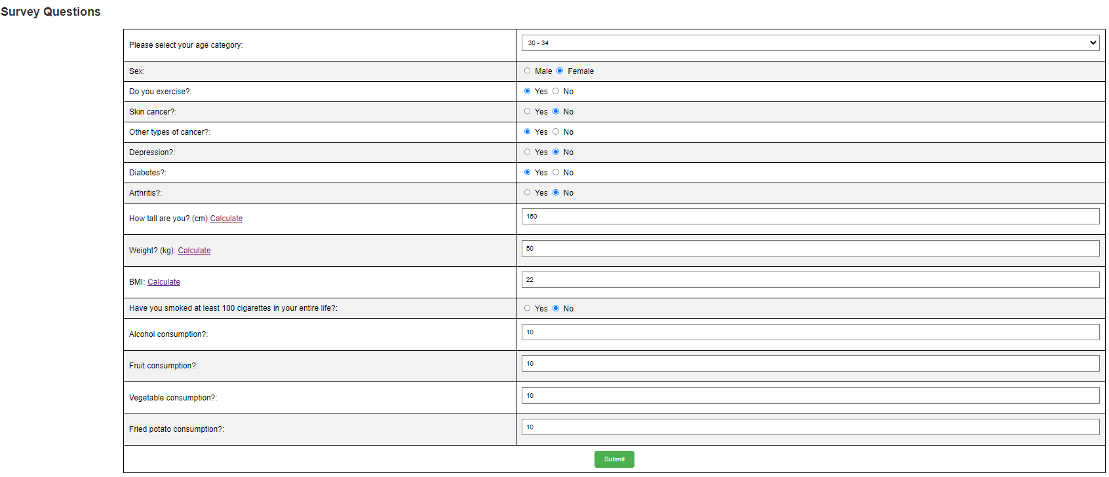
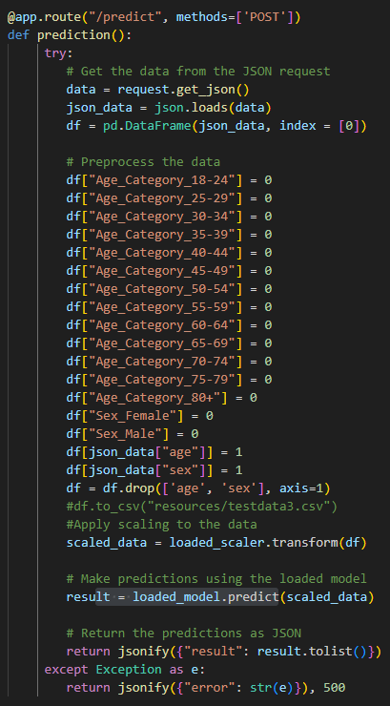
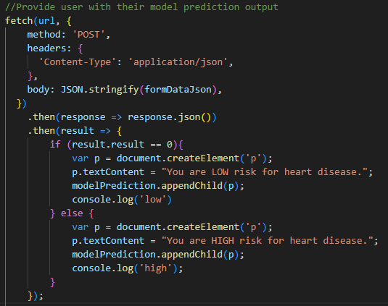
Deploying the model with a python flask api
HTML based survey
Flask API
Create ML model in Python
Now flask API doesn’t need to fit the model each time it is accessed. We can use the already created model to run predictions on.
results.js
Save model and scalar as .pkl files
POST API call

Slide 14
Live demo

Slide 15




Summary
Overall, we were unable to find a satisfactory machine learning model to predict heart disease.
Even though the models give very high accuracy, the problem is that the models are really bad at predicting if people are high risk for heart disease (ie high false negative rate)
This elaborates the difficulty of using machine learning for predicting health issues and how important it is to have models with high precision not just high accuracy when it comes to making medical diagnoses.
Due to this data being unbalanced with not enough entries of people with cardiovascular disease, we would like to find additional data of people with this disease to help balance the data better and increase our accuracy

Slide 16

Questions?

